Slide 1

ANÁLISIS GEOESPACIAL
EDIER V. ARISTIZÁBAL G.
Ing. Geólogo (Universidad Nacional de Colombia)
Esp. en Gestión de Riesgos Geológicos (Universidad de Ginebra – Suiza)
MSc. en Geociencias (Universidad de Shimane – Japón)
PhD. en Ingeniería (Universidad Nacional de Colombia)
Universidad Nacional de Colombia
Facultad de Minas
Departamento de Geociencias

Slide 2

REGRESIÓN LINEAL

Slide 3

REGRESIÓN LINEAL EN MACHINE LEARNING
Using the relationship between variables to find the best fit line or the regression equation that can be used to make predictions
The objective of a linear regression model is to find a relationship between one or more features (independent variables) and a continuous target variable (dependent variable).
When there is only feature it is called Univariate Linear Regression and if there are multiple features, it is called Multiple Linear Regression.
A linear regression model in two dimensions is a straight line; in three dimensions it is a plane, and in more than three dimensions, a hyperplane.

Slide 4
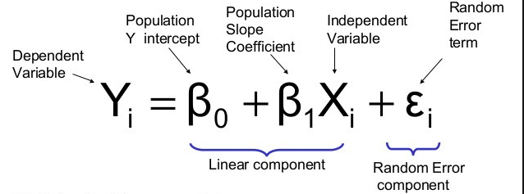
REGRESIÓN LINEAL SIMPLE

Slide 5
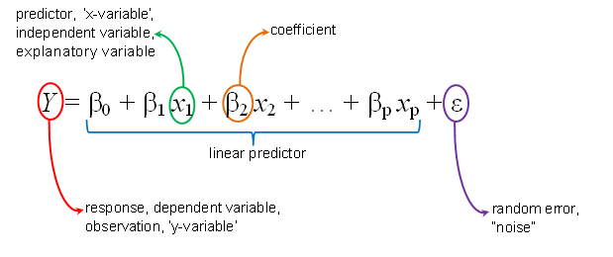
MULTIPLE REGRESIÓN LINEAL

Slide 6
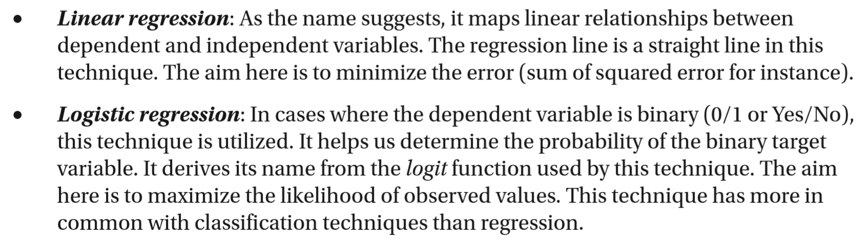
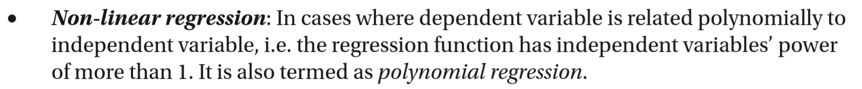
MODELOS LINEALES ?

Slide 7
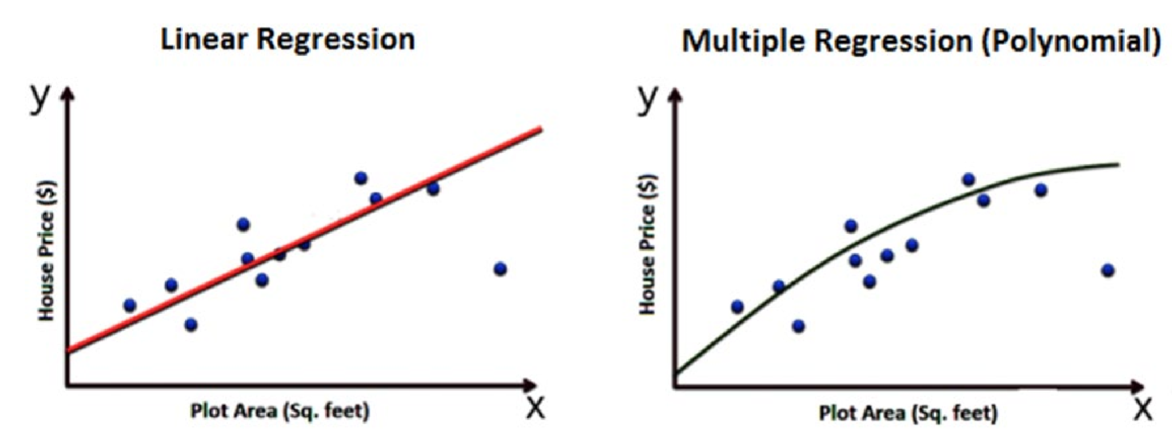
MODELOS LINEALES ?

Slide 8
MODELOS LINEALES ?
To generate a higher order equation we can add powers of the original features as new features. The linear model,
can be transformed to
This is still considered to be linear model as the coefficients/weights associated with the features are still linear. x² is only a feature. However the curve that we are fitting is quadratic in nature.

Slide 9
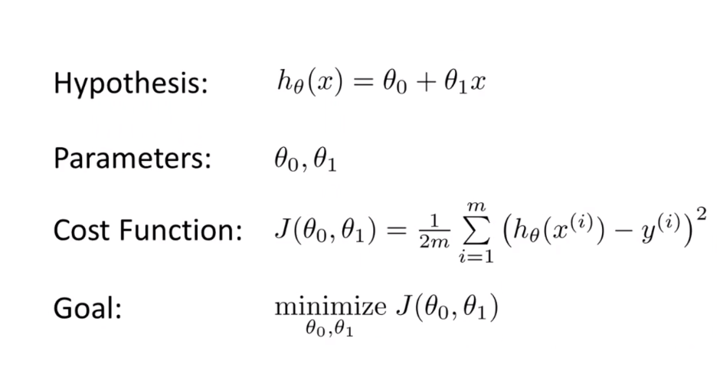

Slide 10
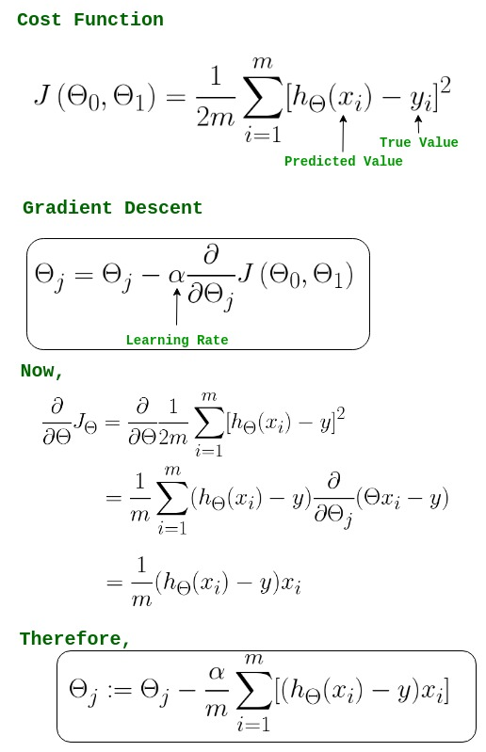

Slide 11
REGRESIÓN LINEAL ?

Slide 12
REGRESIÓN LINEAL ?
if we know that our data is correlated, but the relationship doesn’t look linear? So hence depending on what the data looks like, we can do a polynomial regression on the data to fit a polynomial equation to it.
y = θo + θ₁x₁ + θ₂ x₁²

Slide 13
REGRESIÓN LINEAL POLINOMIAL
Advantages of using Polynomial Regression:
Polynomial provides the best approximation of the relationship between the dependent and independent variable.
A Broad range of function can be fit under it.
Polynomial basically fits a wide range of curvature.
Disadvantages of using Polynomial Regression:
The presence of one or two outliers in the data can seriously affect the results of the nonlinear analysis.
These are too sensitive to the outliers.
In addition, there are unfortunately fewer model validation tools for the detection of outliers in nonlinear regression than there are for linear regression.

Slide 14
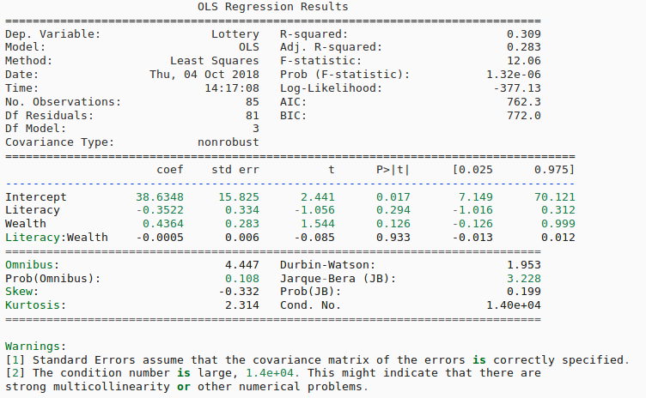
MÉTRICA PARA REGRESIÓN LINEAL

Slide 15
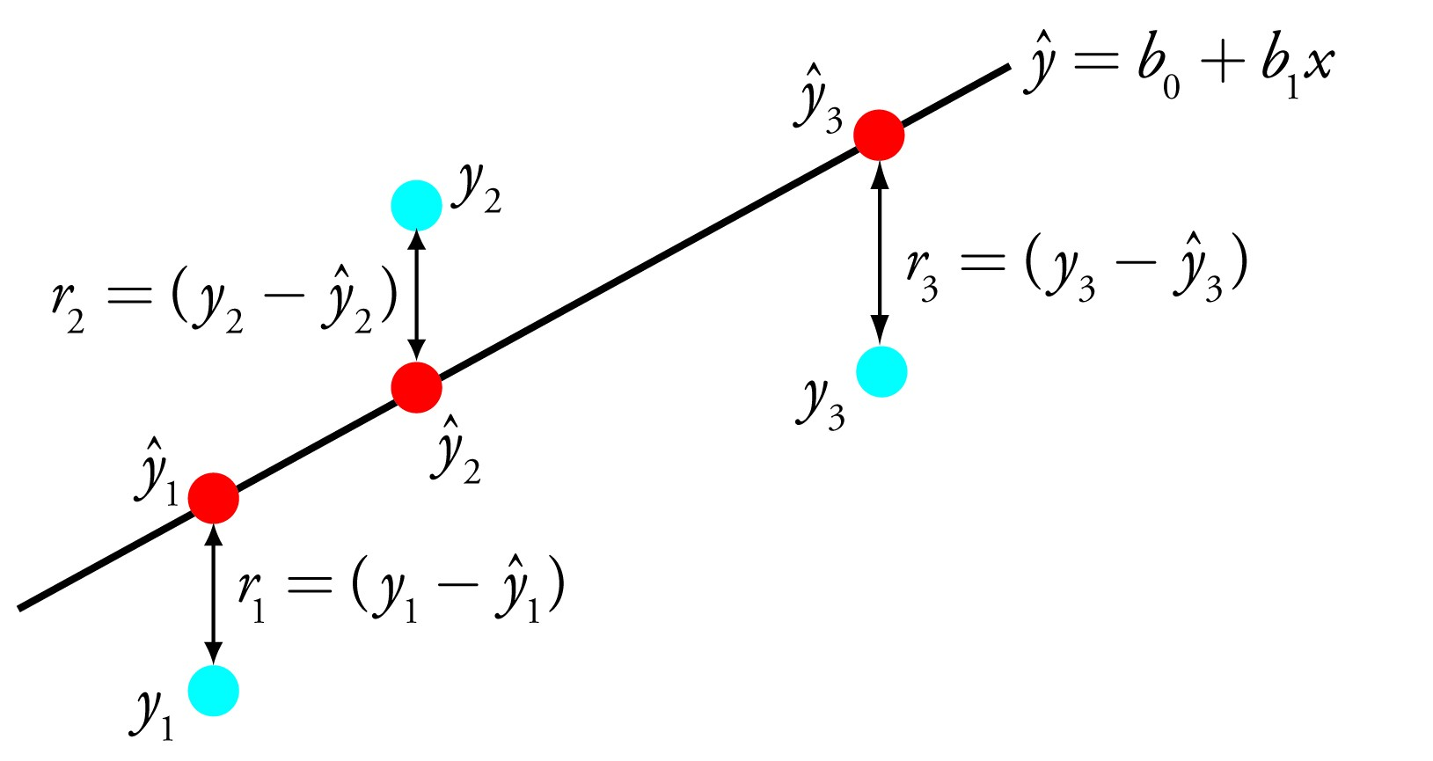
MÉTRICA PARA REGRESIÓN LINEAL

Slide 16
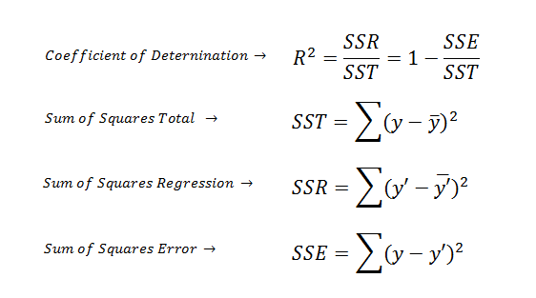
MÉTRICA PARA REGRESIÓN LINEAL

Slide 17
MÉTRICA PARA REGRESIÓN LINEAL

Slide 18
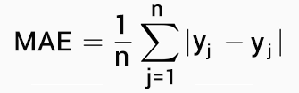
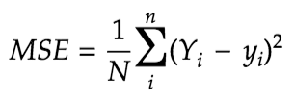

MÉTRICA PARA REGRESIÓN LINEAL
Mean Absolute Error (MAE) is the mean of the absolute value of the errors. It is calculated as:
2. Mean Squared Error (MSE) is the mean of the squared errors and is calculated as:
3. Root Mean Squared Error (RMSE) is the square root of the mean of the squared errors:

Slide 19
MÉTRICA PARA REGRESIÓN LINEAL

Slide 20
SELECCIÓN DEL MODELO

Slide 21
SELECCIÓN DEL MODELO

Slide 22
SELECCIÓN DEL MODELO
Feature Importance
The importance of a feature in a linear regression model can be measured by the absolute value of its t-statistic. The t-statistic is the estimated weight scaled with its standard error.
Let us examine what this formula tells us: The importance of a feature increases with increasing weight. This makes sense. The more variance the estimated weight has (= the less certain we are about the correct value), the less important the feature is. This also makes sense.

Slide 23

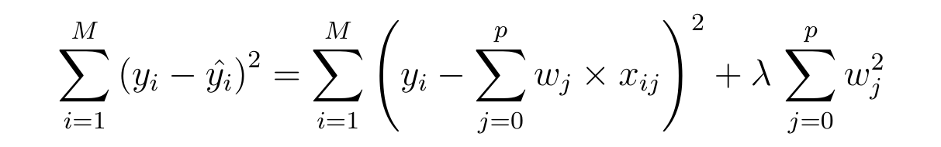
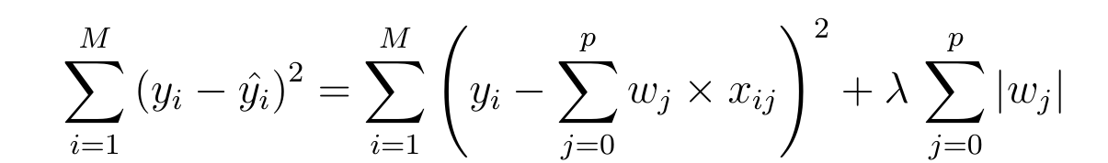
PENALIZED LINEAR REGRESSION
The fundamental goal of machine learning is for the algorithm to generalize beyond the training sets.
We want to penalize or adjust each weights of the independent variables so that it makes a good prediction on test set that it has not seen before.
Regularization will help select a midpoint between the first scenario of high bias and the later scenario of high variance.
Ridge (L2)
Lasso (L1)

Slide 24
REGULARIZATION
λ is the tuning parameter that decides how much we want to penalize the flexibility of our model. The increase in flexibility of a model is represented by increase in its coefficients, and if we want to minimize the above function, then these coefficients need to be small.
Ridge: The coefficient estimates produced by this method are also known as the L2 norm.
Lasso. his variation differs from ridge regression only in penalizing the high coefficients this is known as the L1 norm.
This sheds light on the obvious disadvantage of ridge regression, which is model interpretability. It will shrink the coefficients for least important predictors, very close to zero. But it will never make them exactly zero. In other words, the final model will include all predictors. However, in the case of the Lasso, the L1 penalty has the eﬀect of forcing some of the coeﬃcient estimates to be exactly equal to zero when the tuning parameter λ is suﬃciently large. Therefore, the lasso method also performs variable selection and is said to yield sparse models.

Slide 25
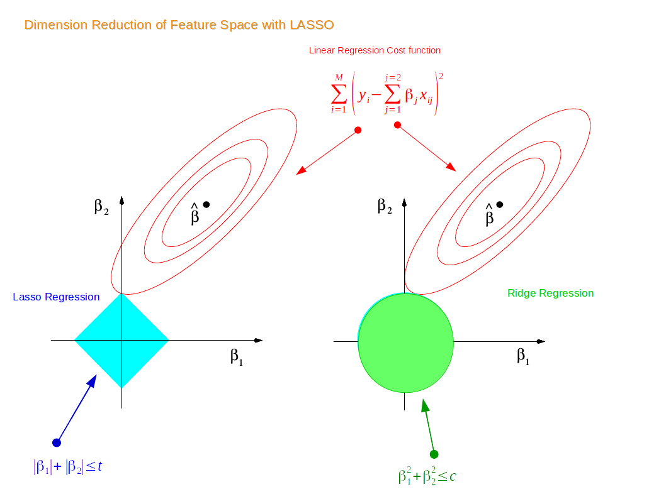
RIDGE vs LASSO

Slide 26
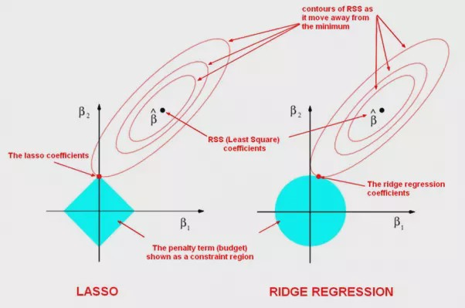
RIDGE vs LASSO

Slide 27
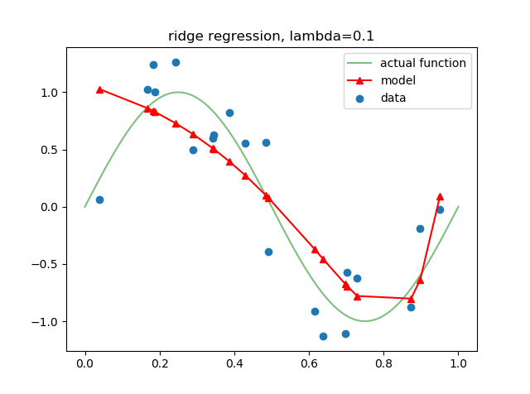
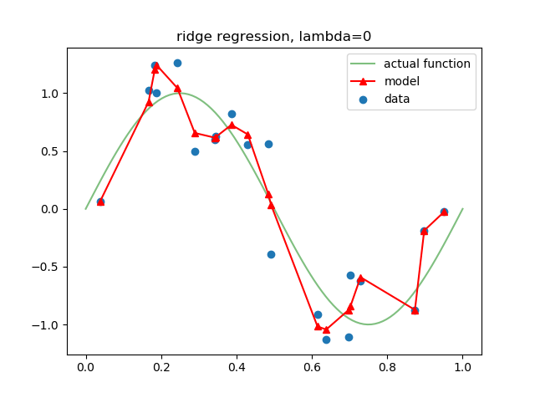
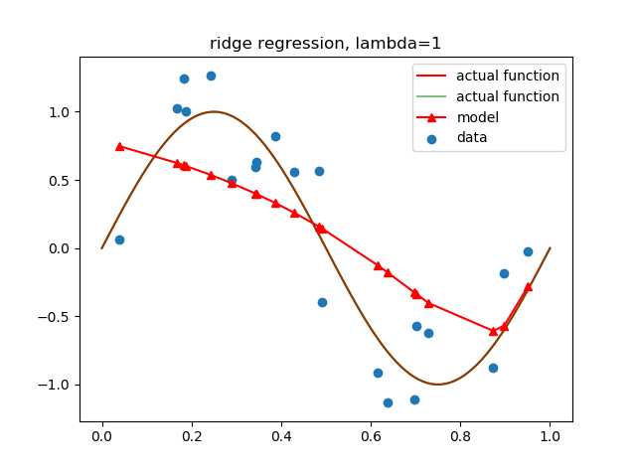
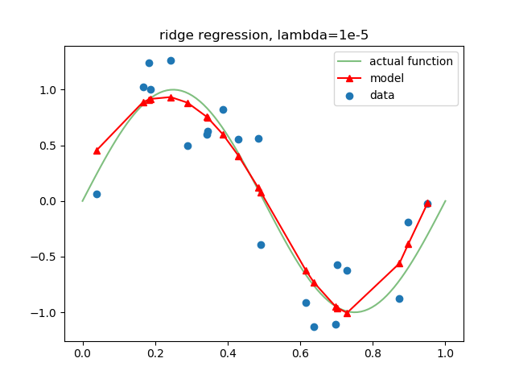
RIDGE L2

Slide 28
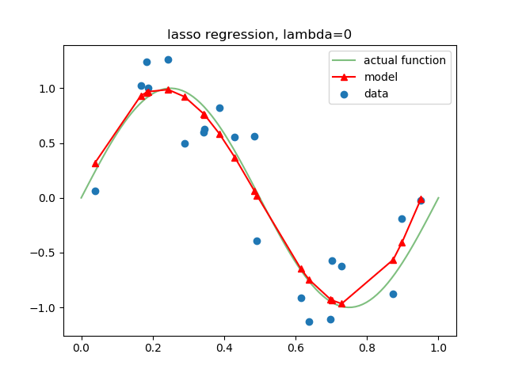
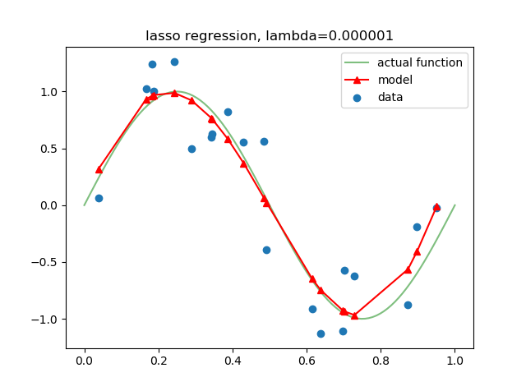
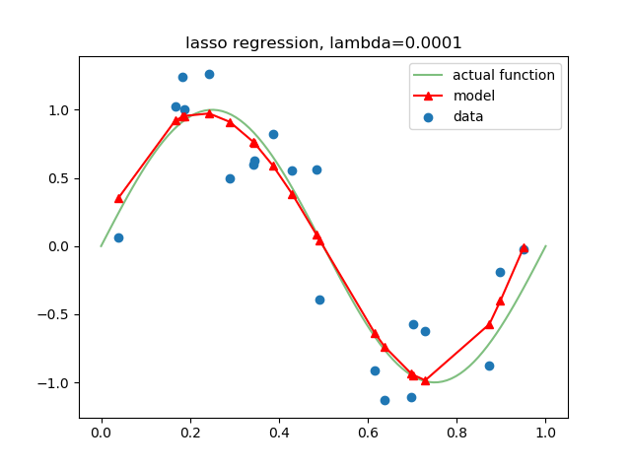
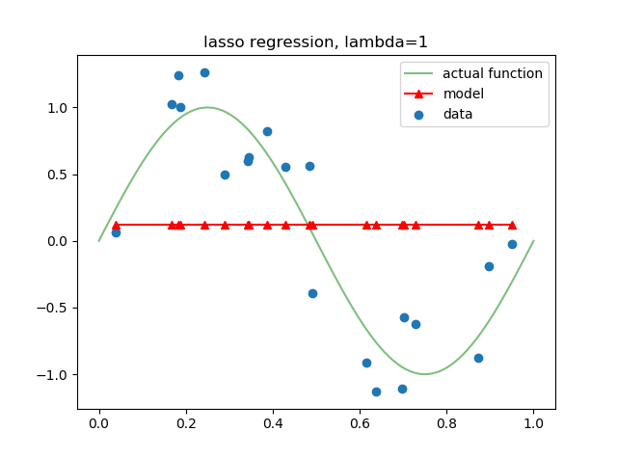
LASSO L1

Slide 29
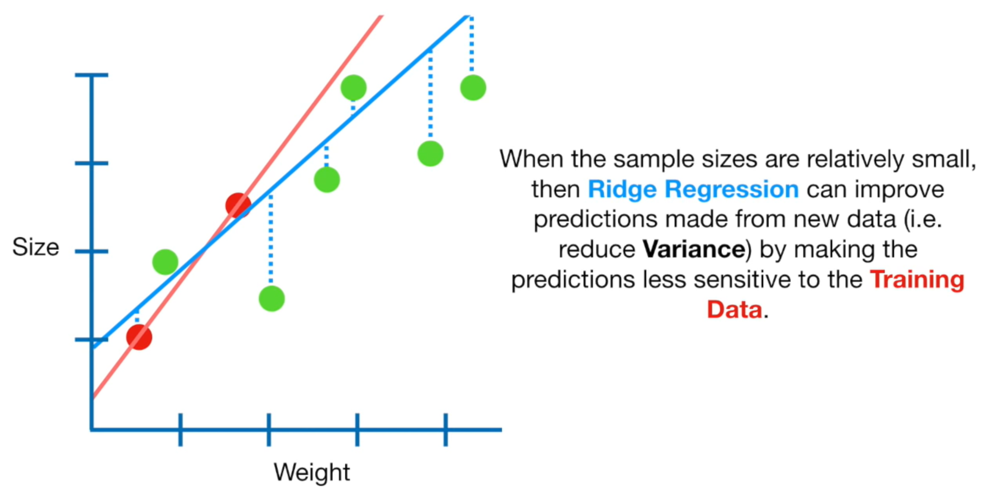
REGULARIZATION

Slide 30
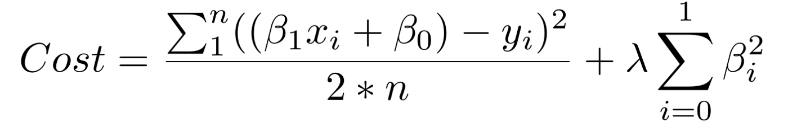
REGULARIZACIÓN
The first piece of the sum above is our normal cost function. The second piece is a regularization term that adds a penalty for large beta coefficients that give too much explanatory power to any specific feature. With these two elements in place, the cost function now balances between two priorities: explaining the training data and preventing that explanation from becoming overly specific.
The lambda coefficient of the regularization term in the cost function is a hyperparameter: a general setting of your model that can be increased or decreased (i.e. tuned) in order to improve performance. A higher lambda value will more harshly penalize large beta coefficients that could lead to potential overfitting. To decide the best value of lambda, you’d use a method called cross-validation which involves holding out a portion of the training data during training, and then seeing how well your model explains the held-out portion. We’ll go over this in more depth

Slide 31
REGULARIZATION
A standard least squares model tends to have some variance in it, i.e. this model won’t generalize well for a data set different than its training data. Regularization, significantly reduces the variance of the model, without substantial increase in its bias.
So the tuning parameter λ, used in the regularization techniques controls the impact on bias and variance. As the value of λ rises, it reduces the value of coefficients and thus reducing the variance. Till a point, this increase in λ is beneficial as it is only reducing the variance (hence avoiding overfitting), without loosing any important properties in the data.
But after certain value, the model starts loosing important properties, giving rise to bias in the model and thus underfitting. Therefore, the value of λ should be carefully selected.

Slide 32
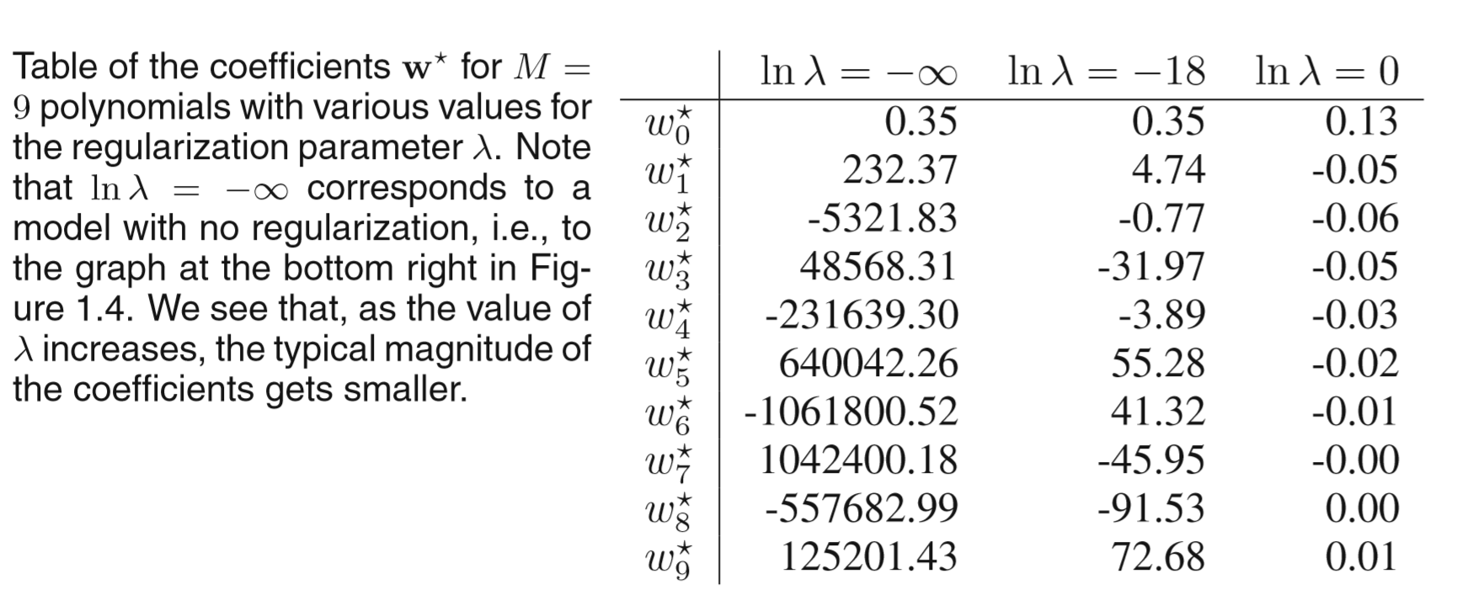
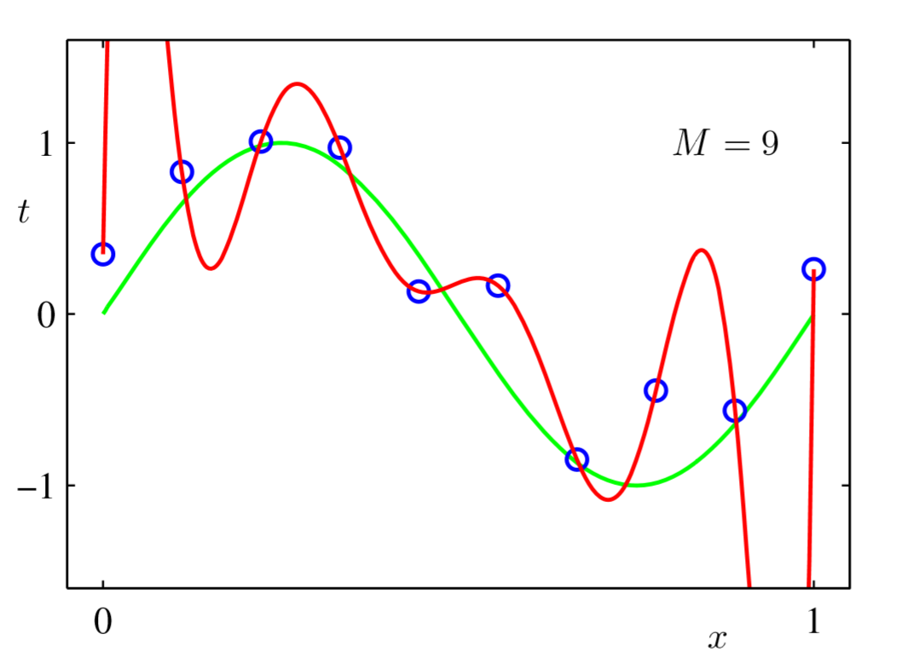
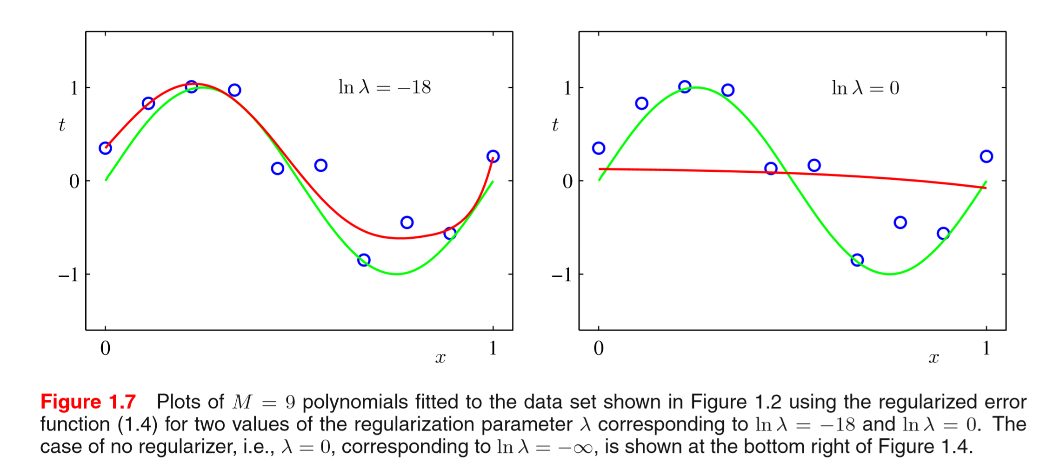
REGULARIZATION

